Slide 1
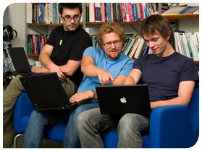



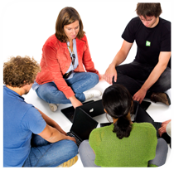

.
Qt in Education
Networking
and
Integrating
the Web
Notes:
This lecture covers networking with Qt – ranging from QtWebKit, network access classes such as QNetworkAccessManager and QFtp, to sockets for TCP (including SSL) and UDP.
Recommended reading before this lecture:
http://doc.trolltech.com/qq/qq26-webplugin.html
http://doc.trolltech.com/qq/32/qq32-webkit-protocols.html
http://doc.trolltech.com/4.6/network-fortuneserver.html

Slide 2


© 2011 Nokia Corporation and its Subsidiary(-ies).
The enclosed Qt Materials are provided under the Creative Commons
Attribution-Share Alike 2.5 License Agreement.
The full license text is available here:
http://creativecommons.org/licenses/by-sa/2.5/legalcode.
Nokia, Qt and the Nokia and Qt logos are the registered trademarks
of Nokia Corporation in Finland and other countries worldwide.

Slide 3

Networking in Qt
The QtWebKit module provides a full web renderer, JavaScript engine, and more
QNetworkAccessManager provides an interface for sending requests and receiving replies over networks
QFtp implements client side ftp
QTcpSocket and QTcpServer provide TCP sockets
  QSslSocket provides encrypted TCP sockets
QUdpSocket provides access to UDP sockets
Notes:
Qt provides networking at many levels. When discussing networking stacks, one often discusses the levels from the physical wire, through protocols and details all the way to the final user application.
Much of this can be seen in Qt as well.
At the application level, Qt provides the QtWebKit module. It contains a full web renderer with JavaScript capabilities and more
Just underneath the browser follows the QNetworkAccessManager which lets you send requests and receive replies over the network.
The QFtp class implements and ftp client.
Under these classes we find the sockets – QUdpSocket, QTcpSocket and QTcpServer.
For your security needs, the QSslSocket provides encrypted sockets.

Slide 4

QtWebKit
Based on the Open Source
WebKit engine
WebKit is basis for Apple's Safari browser, and numerous other browsers
Apple originally based WebKit on KHTML and KJS from KDE
KDE is built upon Qt technology
Notes:
The QtWebKit module is a Qt port of the Open Source WebKit engine used in Apple's Safari browser.
This rendering engine is now being used in numerous browsers such as Google Chrome, Safari, Android's browser, reKonq, etc
The inclusion of WebKit into Qt can be said to close the circle. Apple built WebKit using the KHTML and KJS modules of KDE, and KDE is built on Qt technology.
Continues

Slide 5
What is QtWebKit
Web rendering engine
JavaScript engine
Classes for integrating Qt and web contents to create hybrid applications
Notes:
Looking at WebKit, it is not a web browser as such, even if it can be used to build one
It is a rendering engine – it can render HTML to what the user expects to see on screen
It also contains a JavaScript engine for web pages executing on the client
Qt's integration of WebKit includes classes for integrating Qt into the web, and the web into Qt. The idea behind this is to be able to create hybrid applications
Continues

Slide 6
WebKit's Rendering Capabilities
HTML 4.01, and parts of HTML 5
  2D canvas
  Audio video playback
  Off-line applications
  Web workers, storage and SQL database
CSS 1+2, and parts of CSS 3
  Backgrounds and borders
  Fonts
  2D and 3D transformations
  Transitions and animations
Notes:
The WebKit module can handle most standards expected from a modern browser. For instance:
- support for HTML 4.01, and partial support for HTML 5.
In HTML 5, the 2D canvas, audio and video playback, offline applications, webworkers (threads), storage and SQL database access are supported.
- support for CSS 1 and 2, and partial support for CSS 3
In CSS 3, webkit supports backgrounds, borders and fonts, but also transformations in both 2D and 3D, as well as transitions and animations.

Slide 7
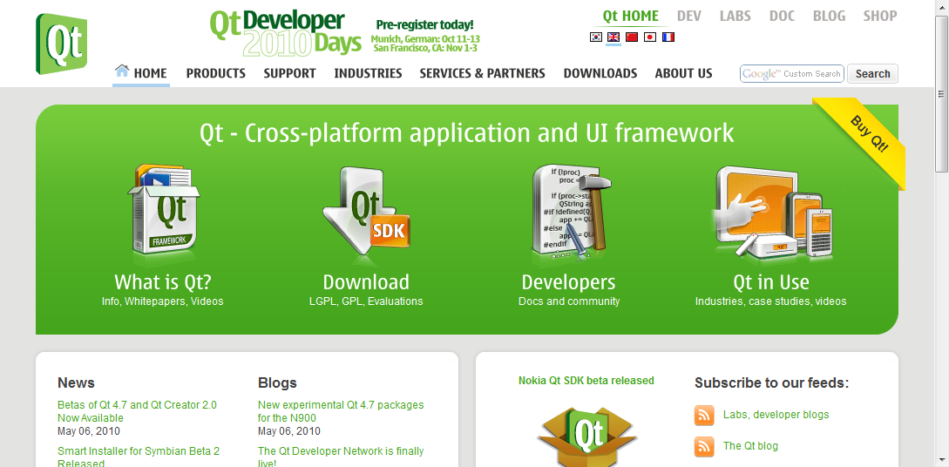
Viewing a web page
QWebView
QWebPage
QWebFrame
Notes:
When viewing a web page through the QWebView widget, you actually invoke a whole tree of objects
The web view is only a view onto a QWebPage
Each web page then consists of one or more QWebFrame objects
Continues

Slide 8
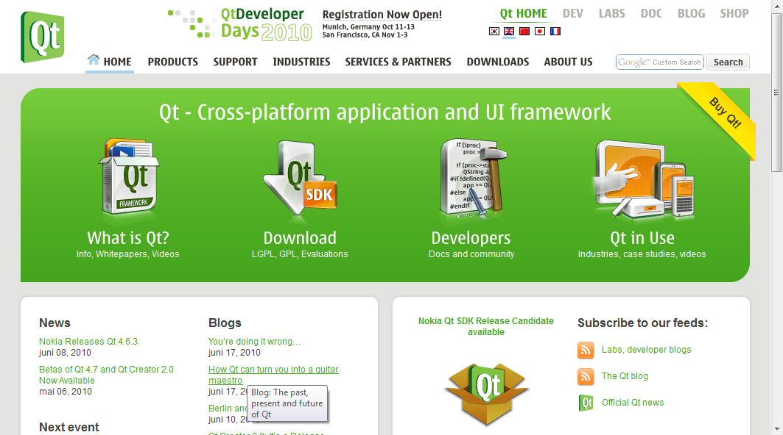
Viewing a web page
QWebView *view = new QWebView();
view->load(QUrl("http://qt.nokia.com"));
Notes:
Using the web view to show a page is simple though, simply tell it to load a URL and it handles the rest
A QWebView widget contains a fully fledged web renderer, containing the QWebPage and QWebFrames
To add functionality such as back, forward, bookmarks, address field, etc you must add widgets around the QWebView and make appropriate connections and calls

Slide 9
Hybrid Applications
By integrating your application with a web page, the user is given a familiar interface while you can focus on the functionality
Integration means
  Embedding Qt contents in web pages
  Accessing web and JavaScript from Qt
  Accessing Qt from JavaScript
Notes:
One key concept for QtWebKit is the ability to create hybrids between web and desktop applications
This way, you can provide your users with a familiar look and feel, and still take advantage of desktop-only technologies
QtWebKit lets you integrate the web and your application in several ways
You can embed Qt components directly in a web page
You can access the web and JavaScript from Qt
You can access Qt from JavaScript (running in the web page)
The end result is a fully integrated web and application, where parts of the application consists of web contents, while part of the web consists of application components.
Continues

Slide 10
Embedding Widgets
It is possible to integrate QWidgets in HTML pages as plugins
When a web page contains the object tag, Qt looks up the mime-type
The mime-type is used to query the available QWebPluginFactory instances
If the type matches, the plugin factory is requested to create a widget
Notes:
They way that you embed Qt components into your web page is to embed Qt widgets into it
QWidgets can easily be exposed to WebKit through plugins
When encountering object-tags in the HTML, Qt will look up the object's mime-type
Using the mime-type, a QWebPluginFactory will create the appropriate widget which then is placed on the HTML page
Continues

Slide 11
Integrating a QWidget
A detailed look at integrating the QCalendarWidget into a web page
  The HTML code needed
  The plugin factory
  Handling properties
  Enabling plugins in webkit
Notes:
We will now have a look at how to integrate a widget with a web page.
As a starting point, we will use the QCalendarWidget, as it provides useful functionality
The solution consists of a piece of HTML to request the widget
A plugin factory that can match the HTML request to the creating of the actual widget
Some code for handling properties sent from HTML to the factory
And finally, how to enable plugins in QtWebKit
Continues

Slide 12
Embedding Widgets
Widgets are embedded through the object tag
<html>
<body>
<h1>Integrated Widget</h1>
<p>
<object type="application/x-qt-calendar">
<param name="gridVisible" value="true" />
</object>
&nbsp;
<object type="application/x-qt-calendar">
<param name="gridVisible" value="false" />
</object>
</p>
</html>
Notes:
From the HTML perspective the object tags list a type which controls which widget is created
The param tags are optional. They are used to set values to properties of the embedded widget. In this example, the gridVisible property is set to true.
Continues

Slide 13
Embedding Widgets
A QWebPluginFactory object is used to create widgets from mime-types
#include <QWebPluginFactory>
class PluginFactory : public QWebPluginFactory
{
Q_OBJECT
public:
explicit PluginFactory(QObject *parent = 0);
QObject *create(const QString &mimeType,
const QUrl &url,
const QStringList &argumentNames,
const QStringList &argumentValues) const;
QList<Plugin> plugins() const;
};
Notes:
For Qt to be able to interpret the object tag with a request for a given type to a widget, a QWebPluginFactory must be able to support the type
For this, we create PluginFactory, derived from QWebPluginFactory
It has a constructor, a create method and a plugins method.
The idea behind the plugins part is that each factory can serve several types of widgets. The Plugin list basically lists the mime-types supported by this plugin
Continues

Slide 14
Embedding Widgets
QObject *PluginFactory::create(const QString &mimeType,
const QUrl &url, const QStringList &argumentNames,
const QStringList &argumentValues) const
{
QWidget *result = 0;
if(mimeType == "application/x-qt-calendar")
{
result = new QCalendarWidget();
for(int i=0; i<argumentNames.count(); ++i)
result->setProperty(argumentNames[i].toLatin1().constData(),
argumentValues[i]);
}
return result;
}
Notes:
The create method does the interesting work.
It ensures that the requested mime-type is correct, then creates a new widget. In this case, a QCalendarWidget
It then iterates over all arguments given (i.e. the param tags) and sets the properties of the widget accordingly.
Notice that the method returns a QObject pointer. It is important to be aware of the fact that only QWidget derived classes and QGraphicsWidget derived classes are accepted.
Continues

Slide 15
Embedding Widgets
Before plugins can be loaded, they must be enabled through the QWebSettings object of the view
The plugin factory must then be set in the page
QWebView view;
view.settings()->setAttribute(
QWebSettings::PluginsEnabled, true);
view->page()->setPluginFactory(
new PluginFactory(this));
Notes:
Before the plugins can be loaded, WebKit must be made aware of the plugin factory and plugin support must be enabled
Enabling the support for plugins is managed through the web settings object associated with the view
Simply set the PluginsEnabled attribute to true
We then set the plugin factory as the plugin factory for the page of the view
Continues

Slide 16
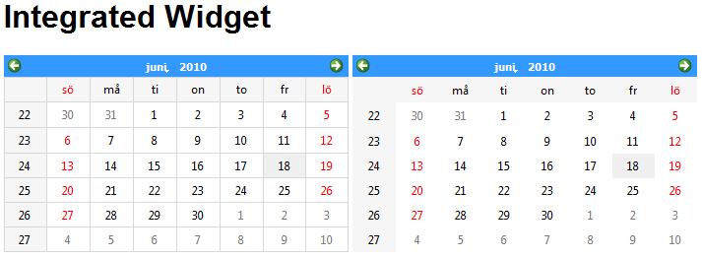
Embedding Widgets
<html>
<body>
<h1>Integrated Widget</h1>
<p>
<object type="application/x-qt-calendar">
<param name="gridVisible" value="true" />
</object>
&nbsp;
<object type="application/x-qt-calendar">
<param name="gridVisible" value="false" />
</object>
</p>
</html>
Notes:
The final result is two QWidgets integrated on the web page, with different property settings handled through the param tags

Slide 17
Accessing DOM from Qt
The Document Object Model is accessible through the QWebElement class
QWebFrame
QWebElement
QWebPage
Notes:
The DOM, Document Object Model, of any webpage being shown is available through the QWebElement class.
Each frame of a given page contains web elements that correspond to the structure of the HTML document
Using these objects, it is possible to inspect and modify the DOM of a given web page
Continues

Slide 18
Navigating the DOM
Each QWebFrame contains a documentElement.
This is the root element of the frame
QWebView *view = ...;
QWebFrame *frame =
view->page()->currentFrame();
QWebElement documentRoot =
frame->documentElement();
Notes:
To traverse the DOM tree, you must first locate the root element of a frame
To do that, you must find the frame
Given a web view showing the page that you're interested in, you can get the current frame through the page's currentFrame method
In most scenarios, there is only one frame. If there are several frames, you might want to use the mainFrame method, and look for your specific frame using the childFrames method in the QWebFrame returned
When you have a frame, use the documentElement to find the root element of the DOM shown in the frame
Continues

Slide 19
Navigating the DOM
From each QWebElement it is possible to traverse or search
  traversing
    firstChild – returns the first child element
    nextSibling – returns the next sibling element
    isNull – is true if there are no children / siblings
  searching
    findFirst and findAll – takes a CSS2 selector as argument, e.g. findAll(".class tag")
Notes:
QWebElement objects represent the structure that the HTML tags build.
From each web element, you can traverse the child elements using the firstChild and nextSibling methods. The web element returned returns true from the isNull method if there are no child elements, or the last sibling has been reached.
You can also search for specific elements. Using findFirst or findAll, you can search using CSS2 (cascading style sheets, version 2) selectors as arguments.
Using these two approaches, you can find the specific elements that you are looking for.
Continues

Slide 20
Inspecting the DOM
Each QWebElement holds information about the current DOM element
e.tagName = "A"
e.toPlainText = "Qt Road map"
e.classes = QStringList()
e.attributeNames = QStringList("href")
e.attribute("href") = "http://qt.nokia.com/developer/qt-roadmap"
<a href="http://qt.nokia.com/developer/qt-roadmap">Qt Road map</a>
Notes:
When you have located a specific web element, you can examine it
The tagName property holds the name of the tag, i.e. the first word of the tag
The toPlainText method returns the contents as plain text
You can get a list of classes that the tag belongs to using the classes property
The attributeNames and attribute methods can be used to examine which attributes are available and what they are set to
Continues

Slide 21
Modifying the DOM
It is possible to modify QWebElements in a multitude of ways
  encloseWith – encloses the element in another element
  setAttribute – sets an attribute
  toggleClass – toggles a class
  setPlainText / setInnerXml – replaces the contents of the element
  setOuterXml – replaces the element and its contents
Notes:
It is also possible to modify web elements. This can be done in many ways
The encloseWith method lets you enclose the element in another element
setAttribute sets attributes
toggleClass lets you toggle whether the element belongs to a class or not
The setPlainText / setInnerXml methods lets you replace the contents of the element
The setOuterXml method replaces the element itself and its contents

Slide 22
JavaScript Integration
It is possible to integrate the Qt object model and JavaScript
  Expose QObjects to JavaScript
  Trigger JavaScript from Qt
Great for mixing Qt and web contents
Notes:
One part of the integration between the web page contents and Qt, is the ability for JavaScript to interact with Qt objects
It is possible to expose QObjects to JavaScript, and it is possible to trigger JavaScripts from Qt
This makes it easy and convenient to mix Qt and web contents
Continues

Slide 23
Exposing QObjects
When exposing a QObject to JavaScript, properties and slots will be made available
Call addToJavaScriptWindowObject on a QWebFrame to add an object to the frame
When a new page is loaded, the object references will be cleared and the javaScriptWindowObjectCleared signal emitted
  Add the objects from a slot connected to that signal
view->page()->currentFrame()->
addToJavaScriptWindowObject("helloqt", javaScriptObject);
Notes:
When you expose a QObject to JavaScript, the script will get access to properties and slots
To expose an object, call the addToJavaScriptWindowObject method of a frame
This lets you add a given object under a given name. In the example, the object javaScriptObject will be known as helloqt on the JavaScript side
Each time a web page is loaded, all object references will be cleared. This is just to ensure that there will be no cross-site-contamination
When the references are cleared, the javaScriptWindowObjectCleared signal is emitted. By connecting this to a slot, it is possible to add the objects to the context again.
Continues

Slide 24
Accessing QObjects
class MyJavaScriptObject : public QObject
{
Q_OBJECT
Q_PROPERTY(QString text READ text WRITE setText)
public:
explicit MyJavaScriptObject(QObject *parent = 0);
const QString &text() const;
public slots:
void setGreeting();
void setText(const QString &text);
...
};
Notes:
Looking at an object intended to be exposed to JavaScript, we make one property available and then all the public slots
This means that this object will have a text property and a setGreeting method
Continues

Slide 25
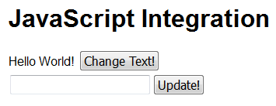
Accessing QObjects
<html>
<body>
<h1>JavaScript Integration</h1>
<div><span id="greeting">Hello World!</span>
<button type="button" onclick="helloqt.setGreeting();">
Change Text!
</button>
</div>
<div>
<input type="text" id="textInput" />
<button type="button" onclick="helloqt.setText(textInput.value);">
Update!
</button>
</div>
</body>
</html>
Notes:
From the HTML side, the methods can be invoked from any JavaScript
In the example here, the scripts have been embedded in tags of the buttons in question
When the “change text” button is clicked, the setGreeting method is called (the slot)
When the “update” button is clicked, the setText method is called with the new text as argument
Continues

Slide 26
Triggering JavaScript
JavaScript can be executed using the evaluateJavaScript method available from QWebFrame and QWebElement
The signal loadFinished is emitted from QWebPage when the page has been fully loaded. This is a good point to trigger JavaScript from
view->page()->currentFrame()->
evaluateJavaScript(QString("textInput.value=\"%1\"").arg(text));
Notes:
It is not only possible to access QObjects from JavaScript. It is also possible to trigger JavaScript from Qt
By calling the evaluateJavaScript method of a frame, the java script code is executed
Connecting to the loadFinished signal of a web page, you have a perfect trigger for executing JavaScripts

Slide 27
Integrating JavaScript
The QWebPage class contains a number of protected methods that need to be considered when integrating JavaScript
  javaScriptAlert
  javaScriptConfirm
  javaScriptConsoleMessage
  javaScriptPrompt
  createWindow
Signals
  windowCloseRequested
  printRequested
Slots
  shouldInterruptJavaScript
Notes:
When integrating JavaScript and Qt in a hybrid application, there are a number of re-implementable methods, signals and slots to be aware of
The methods javaScript* and createWindow can be re-implemented to handle alerts and messages from JavaScript
The signals windowCloseRequested and printRequested must be connected to appropriate slots for these functions to work
The slot shouldInterruptJavaScript handles JavaScripts that run for too long (i.e. might be hung)

Slide 28
Accessing the net
The QtWebKit classes uses the QNetworkAccessManager to access the net
The network access manager provides access to the web without any connections to a user interface. It can
  handle requests and replies
  cache web pages
  keep track of cookies
  use proxies
  act as a protocol translator
Notes:
The QtWebKit classes use the QNetworkAccessManager class to access the internet
The access manager provides access to the web without providing a user interface
It is responsible for handing requests and replies, caching, cookies, proxy settings
It can also intercept traffic and do statistics or translate protocols, etc
Continues

Slide 29
Classes for Network Access
QNetworkRequest
QNetworkReply
QNetworkAccessManager
QNetworkProxyFactory
QAbstractNetworkCache
QNetworkCookieJar
Notes:
When using the QNetworkAccessManager, you use multiple classes
Replies and requests are handled by the QNetworkRequest and QNetworkReply classes
The proxy management is performed using QNetworkProxyFactory
Caching uses the QAbstractNetworkCache interface
The QNetworkCookieJar handles cookies
Continues

Slide 30
Accessing HTTP programatically
Example – download a file via HTTP using QNetworkAccessManager
QNetworkAccessManager *manager = new QNetworkAccessManager(this);
connect(manager, SIGNAL(finished(QNetworkReply*)),
this, SLOT(downloadDone(QNetworkReply*)));
manager->get(QNetworkRequest(QUrl("http://doc.qt.nokia.com/images/logo.png")));
MyClass::downloadDone(QNetworkReply *reply)
{
QImageReader reader(reply, "png");
mImage = reader.read());
emit imageChanged(mImage);
reply->deleteLater();
}
Notes:
Using the an access manager, you can do anything that the user can do via the web browser
For instance, the snippet above demonstrates how to download a file via the HTTP protocol and to parse the result
This is naive, however, as there is no error handing what so ever.
Continues

Slide 31
QNetworkAccessManager for interfacing other protocols
By sub-classing the QNetworkAccessManager it is possible to provide a web-like interface to any data source
As the QtWebKit classes use the network access manager for network access it is possible to use them with alternate data sources
Qt Quarterly contains an example of implementing an FTP browser using this approach
http://doc.qt.nokia.com/qq/32/qq32-webkit-protocols.html
Notes:
By sub-classing the QNetworkAccessManager class and creating your own access manager, you can provide a web interface to any data source
For instance, you can dynamically translate an FTP session into web pages to show in a QWebView
As the QtWebKit classes use an access manager for interfacing the network, it is possible to have all traffic pass through your custom access manager

Slide 32
Break

Slide 33
Protocols
Browsing the web uses the HTTP protocol
  Hyper-Text Transfer Protocol
  Sometimes encrypted as https
HTTP is built on top of TCP which is built on top of IP
There are many other protocols built on top of TCP/IP, e.g. FTP, SMTP, POP, IMAP
HTTP, FTP, SMTP,
POP, IMAP, etc
TCP
IP
(IPv4 and IPv6)
Notes:
When browsing the web, you usually rely on HTTP, the hyper text transfer protocol
Sometimes you encounter HTTPS, which is the same protocol, only encrypted
HTTP is built on top of TCP, which is a protocol to handle transfers of packets.
TCP in turn is built upon the IP protocol, which forms the base of the internet
There are many more protocols built on TCP/IP – FTP, SMTP, POP; IMAP, bittorrent, etc I'm sure you've encountered more.

Slide 34
FTP
The QFtp class encapsulates the FTP protocol
  File Transfer Protocol
FTP lets you
  log into servers
  list files
  move around the file system
  upload and download files
Notes:
The QFtp class encapsulates the FTP protocol from the client side
FTP stands for file transfer protocol and lets you
log in
list files and directories
traverse the directory tree
download and upload files
The FTP protocol is wide spread and commonly used.
Continues

Slide 35
Downloading a File
To download the file ftp.qt.nokia.com/qt/source/README using a QFtp object, the following steps must be taken
  connectToHost("ftp.qt.nokia.com")
  login
  get("/qt/source/README")
  close
Notes:
As an example of the FTP protocol, let's have a look at the steps involved to download a small file from the Qt Nokia ftp site.
First, you connect to a host by calling connectToHost with the server name
As this is a public ftp, we do not provide any user name nor password. It is still necessary to login though, just to get the protocol into the right state,
The next step is to download the file. That is done by calling get and provide the filename as an argument
The finished download is signaled by the done signal, and you can read all the data using the readAll method
Finally, we close the connection
Continues

Slide 36
Splitting a URL
The QUrl class can be used to split a URL into its parts
ftp://ftp.qt.nokia.com/qt/sources/README
scheme
host
path
QUrl url("ftp://ftp.qt.nokia.com/qt/sources/README");
QString host = url.host();
QString path = url.path();
Notes:
Looking at the download in more detail, lets take it from the beginning.
The URL, given as the address to the file that we want to download, can be split into parts. This is done using the QUrl class
Looking at the full url, we can tell that it uses ftp from the scheme part, the host is the name before the first / while the rest is considered the path
All these components, and more, can be extracted using the QUrl class.
Continues

Slide 37
Downloading a File
Each command requested through QFtp is asyncronous
When a command has finished, the commandFinished(int id, bool error) is emitted
  id – an integer id for each command, returned when requesting the command, e.g. int QFtp::close()
  error – is true if the command has resulted in an error
Notes:
When we have the components of the URL that we need, we can start working with the QFtp object
Every time you tell a QFtp object to call a command, you trigger an asynchronous command
When such a command has finished, the QFtp object emits a commandFinished signal
The signal carries an id for the command in question. This id is returned when requesting each command. And an error flag, indicating whether the command was executed as expected or not.
Continues

Slide 38
Download a File
All commands can be requested at once
Or a simple state machine can be constructed
void Downloader::start()
{
m_ftpState = Connecting;
m_ftp->connectToHost(host);
}
void Downloader::ftpFinished(int, bool error)
{
switch(m_ftpState)
{
case Connecting:
m_ftpState = LoggingIn;
m_ftp->login();
break;
case LoggingIn:
m_ftpState = Downloading;
m_ftp->get(file, 0, QFtp::Ascii);
break;
case Downloading:
result = m_ftp->readAll();
m_ftpState = Disconnecting;
m_ftp->close();
break;
case Disconnecting:
m_ftpState = Inactive;
break;
}
}
Notes:
In theory, all commands can be requested in one go – however that can cause a minor chaos if one command in the middle of a sequence fails.
A better approach is to build a simple state machine.
In the example code here, the m_ftpState variable controls the state machine. In the start method, the first state is set and the first command is requested.
As we only request one command at a time, we ignore the id for the command.
You can see that the state Connection corresponds to the connectToHost command
LoggingIn to the login command
Downloading to the get command – here you can also see the readAll command being called to retrieve the actual data
Disconnecting finally corresponds to the close command
The very final step is to set the state to Inactive, but that is a bit outside the scope of the example

Slide 39
Accessing Socket
HTTP, FTP, etc are all based on TCP and IP
Qt has support for accessing TCP and UDP directly at socket level
HTTP, FTP, SMTP,
POP, IMAP, etc
TCP, UDP
IP
(IPv4 and IPv6)
Notes:
The HTTP and FTP protocols that we have looked at so far are based on TCP and IP.
TCP, the Transmission Control Protocol, is not the only protocol that can be run over IP.
Another common choice is the UDP, the User Datagram Protocol.
For both TCP and UDP, Qt offers classes for accessing these protocols at socket level

Slide 40
Accessing Sockets
TCP Sockets
Guaranteed in-order delivery
Point-to-point only
Great when correct delivery is important
UDP Sockets
Fire and forget
Point-to-point or broadcasts
Great when time is more important than delivery
Notes:
The TCP and UDP sockets have different use cases
TCP is used for point-to-point transfer, where the correct delivery of data is required. An example of this is file transfers.
UDP is used for point-to-point, or broadcasts, where time is of importance. An example of this is internet radio transmissions. It is more important to keep the stream of packets going than to ensure that every single package reaches its destination
As the reception of packages isn't reported back to the sender, it is possible to broadcast using this protocol, i.e. one-to-many communication
Continues

Slide 41
TCP Sockets
There are two TCP classes in Qt
  QTcpSocket – representing a socket
  QTcpServer – representing a server, listening for incoming connections, generating QTcpSocket instances for each connection
We will build a simple server greeting each connection with a text string
Notes:
For TCP traffic, the QTcpSocket and QTcpServer classes are used.
The QTcpSocket represents a socket – either for sending or receiving
The QTcpServer represents a server, listening for incoming connections. For each new connection a new QTcpSocket is created
Let's look at how to put these parts together to build a simple server and client
Continues

Slide 42
A TCP Server
The TCP server consist of a QTcpServer that listens to port 55555
  Generates a newConnection signal
Server::Server() : QObject(0)
{
m_tcpServer = new QTcpServer(this);
connect(m_tcpServer, SIGNAL(newConnection()),
this, SLOT(serverConnected()));
m_tcpServer->listen(QHostAddress::Any, 55555);
}
Notes:
The server uses a QTcpServer object listening to port 55555 from any host
Each time a new connection takes place, the newConnection signal is emitted. This is connected to our serverConnected slot
Continues

Slide 43
A TCP Server
The next connection is retrieved using nextPendingConnection
void Server::serverConnected()
{
QTcpSocket *connection = m_tcpServer->nextPendingConnection();
connect(connection, SIGNAL(disconnected()),
connection, SLOT(deleteLater()));
QByteArray buffer;
...
connection->write(buffer);
connection->disconnectFromHost();
}
Notes:
In the serverConnected slot, we request a new QTcpSocket from the server object using the nextPendingConnection method
We also make a connection so that the new socket object automatically deletes itself when disconnected
Then we setup a buffer which writes to the socket before disconnecting it.
This example server relies on only sending a single answer to the client, in other cases it might have been more natural to keel the tcp object alive for longer. It all depends on the application's needs.
Continues

Slide 44
A TCP Server
The reply is constructed in a buffer
void Server::serverConnected()
{
...
QByteArray buffer;
QDataStream out(&buffer, QIODevice::WriteOnly);
out.setVersion(QDataStream::Qt_4_6);
QString greeting = QString("Hello! The time is %1")
.arg(QTime::currentTime().toString());
out << (quint16)0;
out << greeting;
out.device()->seek(0);
out << (quint16)(buffer.size() - sizeof(quint16));
...
}
When using a
QDataStream
with a socket
it is important
to handle the
size of the data
manually.
Notes:
The construction of the buffer is interesting.
A QByteArray is an array of bytes. By creating a QDataStream to it, we can stream binary data to it.
When using QDataStream objects, it is good to specify the Qt version to use. This ensures that future versions of Qt can use other formatting for data types, while still maintaining backwards compatibility
The next step is to put two bytes (uint16) in the stream followed by the greeting string.
When the greeting is in place, we seek back to the start of the stream and write the size of the buffer to the start of it
The result is a buffer containing its own length first and then the data contents.
The reason for this is that the TCP protocol breaks data streams into packages and we need to be able to tell where our pieces of data are in relation to these packages
Continues

Slide 45
A TCP Client
Use a QTcpSocket to connect to the host
  readyRead is necessary, but there are more signals that are interesting, e.g. error
Client::Client() : QObject(0)
{
m_tcpSocket = new QTcpSocket(this);
connect(m_tcpSocket, SIGNAL(readyRead()),
this, SLOT(readyToRead()));
m_tcpSocket->connectToHost("localhost", 55555);
}
Notes:
The TCP client uses a QTcpSocket directly.
The readyRead signal is emitted as soon as there is data available to read from the socket, so we connected that to our readyToRead slot
Then we connect to “localhost”, i.e. the current computer, to port 55555. This is where we expect the server to be running.
Continues

Slide 46
A TCP Client
void Client::readyToRead()
{
QDataStream in(m_tcpSocket);
in.setVersion(QDataStream::Qt_4_6);
if(m_tcpBlockSize == 0)
{
if(m_tcpSocket->bytesAvailable()<sizeof(quint16))
return;
in >> m_tcpBlockSize;
}
if(m_tcpSocket->bytesAvailable() < m_tcpBlockSize)
return;
QString greeting;
in >> greeting;
doSomething(greeting);
m_tcpBlockSize = 0;
}
Using the
QTcpSocket's
buffer as
our buffer
Notes:
In the readyToRead slot we use the socket as our read buffer.
If we do not know the size of the next message (tcpBlockSize == 0) and have received more than two bytes, we read the block size from the stream
We then simply return until the number of bytes buffered in the socket are more or equal to the size of the message that we expect
When we have enough data, we read the greeting string into a QString object and process it
Finally, we reset the state of the socket by setting tcpBlockSize to zero again
This won't matter in this setting as the server closes the connection each time, but it is still a good habit.
Continues

Slide 47
TCP Protocols
The protocol demonstrated is very basic
  Reply to all connections, then close
A real world protocol would probably
  Keep the connection open and use a set of commands for requesting and manipulating data
  Carry some sort of versioning information
  etc
Notes:
Looking at what we have implemented, we have a very basic protocol that closes the connection as soon as it has replied to the request
A real world protocol would probably keep the connection open and implement some sort of session of commands for performing tasks
It would also probably carry some sort of versioning information, to make sure that it is possible to upgrade servers and clients independently (versioning of the protocol, not the QDataStream version, that is)

Slide 48
Encrypted Sockets
TCP/IP traffic is easy to overhear
QSslSocket provides encrypted TCP sockets
  Use connectToHostEncrypted
SSL, Secure Sockets Layer, is a layer on top of TCP
  Relies on CAs – Certificate Authorities
Notes:
One thing to be aware of is that TCP/IP traffic is easy to overhear
Using QSslSocket, it is possible to encrypt TCP socket traffic
Use the connectToHostEncrypted method to establish a secure connection
SSL, secure socket layer, is a layer on top of TCP
It relies on certificate authorities to guarantee the trust in the other party

Slide 49
UDP Sockets
The QUdpSocket provides a UDP socket
  Usable for both clients and servers
  User Datagram Protocol
Datagrams are sent as one block
  512 bytes is ok, 8192 bytes usually work, larger might be possible
  Can arrive or not
  Can arrive out-of-order
  Can arrive in duplicates
Notes:
The QUdpSocket implements the UDP protocol
In a UDP setting, the data is not guaranteed to arrive. Instead one listens to a port and transmits to a port, both using the QUdpSocket class
It is also possible to broadcast to a subnet of clients using UDP
UDP is based on datagrams, so all data is carried in a single “blob”
The size of these datagrams vary over different platforms and devices. 512 bytes is always ok, and up to 8kB usually work. In some settings, even bigger datagrams can be used
When using UDP, it is good to know that datagrams can
arrive or not arrive
arrive out-of-order
arrive multiple times (i.e. duplicates of the same datagram)

